Slide 1

Computer Networks
Computer networks Models
TCP / OSI

Slide 2
Topic of the day
Network Models
OSI Model
Layered Architecture
Peer to Peer Processes
Interfaces between Layers
Encapsulation

Slide 3
Network Model
A network is a combination of hardware and software that sends data from one location to another.
The hardware consists of the physical equipment that carries signals from one point of the network to another.
The software consists of instruction sets that make possible the services that we expect from a network.

Slide 4
Network Models
OSI Model(Open Systems Interconnection) :
7 Layers
Ideal model
provide reference to guide vendors and developers.
TCP/IP Model (Transmission Control Protocol/ Internet Protocol)
4 Layers, 5 Layer
Implemented in most internet standards
Older than OSI Model
TCP/ IP protocol suite

Slide 5
Layered Tasks
Notes:
We use the concept of layers in our daily life. As an example, let us consider two
friends who communicate through postal maiL The process of sending a letter to a
friend would be complex if there were no services available from the post office

Slide 6
OSI Model
In1970s, the International Standards Organization (ISO) introduced an ISO standard Open Systems Interconnection OSI model.
An open system is a set of protocols that allows any two different systems to communicate regardless of their underlying architecture.
The purpose of the OSI model is to show how to facilitate communication between different systems without requiring changes to the logic of the underlying hardware and software.
The OSI model is not a protocol; it is a model for understanding and designing a network architecture that is flexible, robust, and interoperable.

Slide 7
Layered framework for the design of network systems that allows communication between all types of computer systems.
Seven separate but related layers,
Each layers defines a part of the process of moving information across a network.
An understanding of the fundamentals of the OSI model provides a solid basis for exploring data communications.

Slide 8
Layered Architecture
Peer to Peer Processes
Interfaces between Layers
Encapsulation

Slide 9
Layered Architecture
The OSI model is composed of seven ordered layers: physical (layer 1), data link (layer 2), network (layer 3), transport (layer 4), session (layer 5), presentation (layer 6), and application (layer 7).
As the message travels from A to B, it may pass through many intermediate nodes.
These intermediate nodes usually involve only the first three layers of the OSI model.
Each layer defines a family of functions distinct from those of the other layers.
Within a single machine, each layer calls upon the services of the layer just below it.
This communication is governed by an agreed-upon series of rules and conventions called protocols.

Slide 10
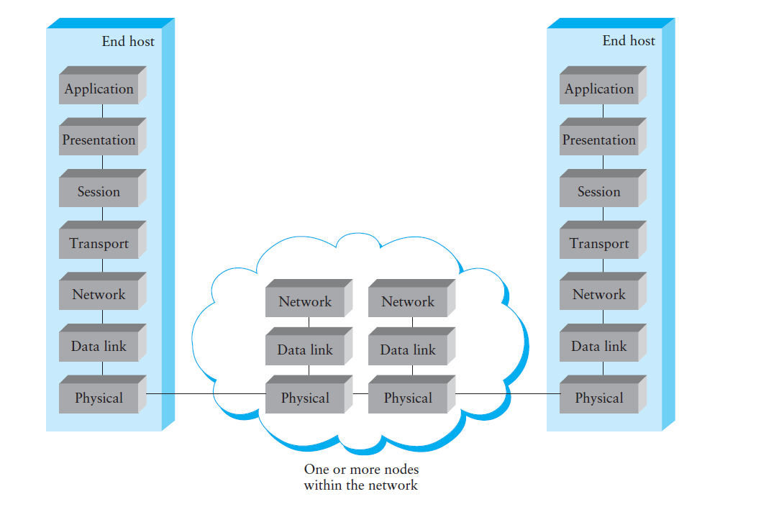

Slide 11
7 Layers of the OSI Model
Layer | Responsible For:
7.) Application | Provides Services to User Apps
6.) Presentation | Data Representation
5.) Session | Communication Between Hosts
4.) Transport | Flow Ctrl, Error Detection/Correction
3.) Network | End to End Delivery, Logical Addr
2.) Data Link | Media Access Ctrl, Physical Addr
1.) Physical | Medium, Interfaces, Puts Bits on Med.

Slide 12
Examples
Layer | Example
7.) Application | HTTP, FTP, SMTP
6.) Presentation | ASCII, JPEG, PGP
5.) Session | BOOTP, NetBIOS, DHCP, DNS
4.) Transport | TCP, UDP, SPX
3.) Network | IP, IPX, ICMP
2.) Data Link | Ethernet, Token Ring, Frame Relay
1.) Physical | Bits, Interfaces, Hubs

Slide 13
Peer to Peer Processes
The processes on each machine that communicate at a given layer are called peer-to-peer processes.
Communication between machines is therefore a peer-to-peer process using the protocols appropriate to a given layer.
Each layer in the sending device adds its own information to the message it receives from the layer just above it and passes the whole package to the layer just below it.
Notes:
Processes interact with the processes at peer layer only

Slide 15
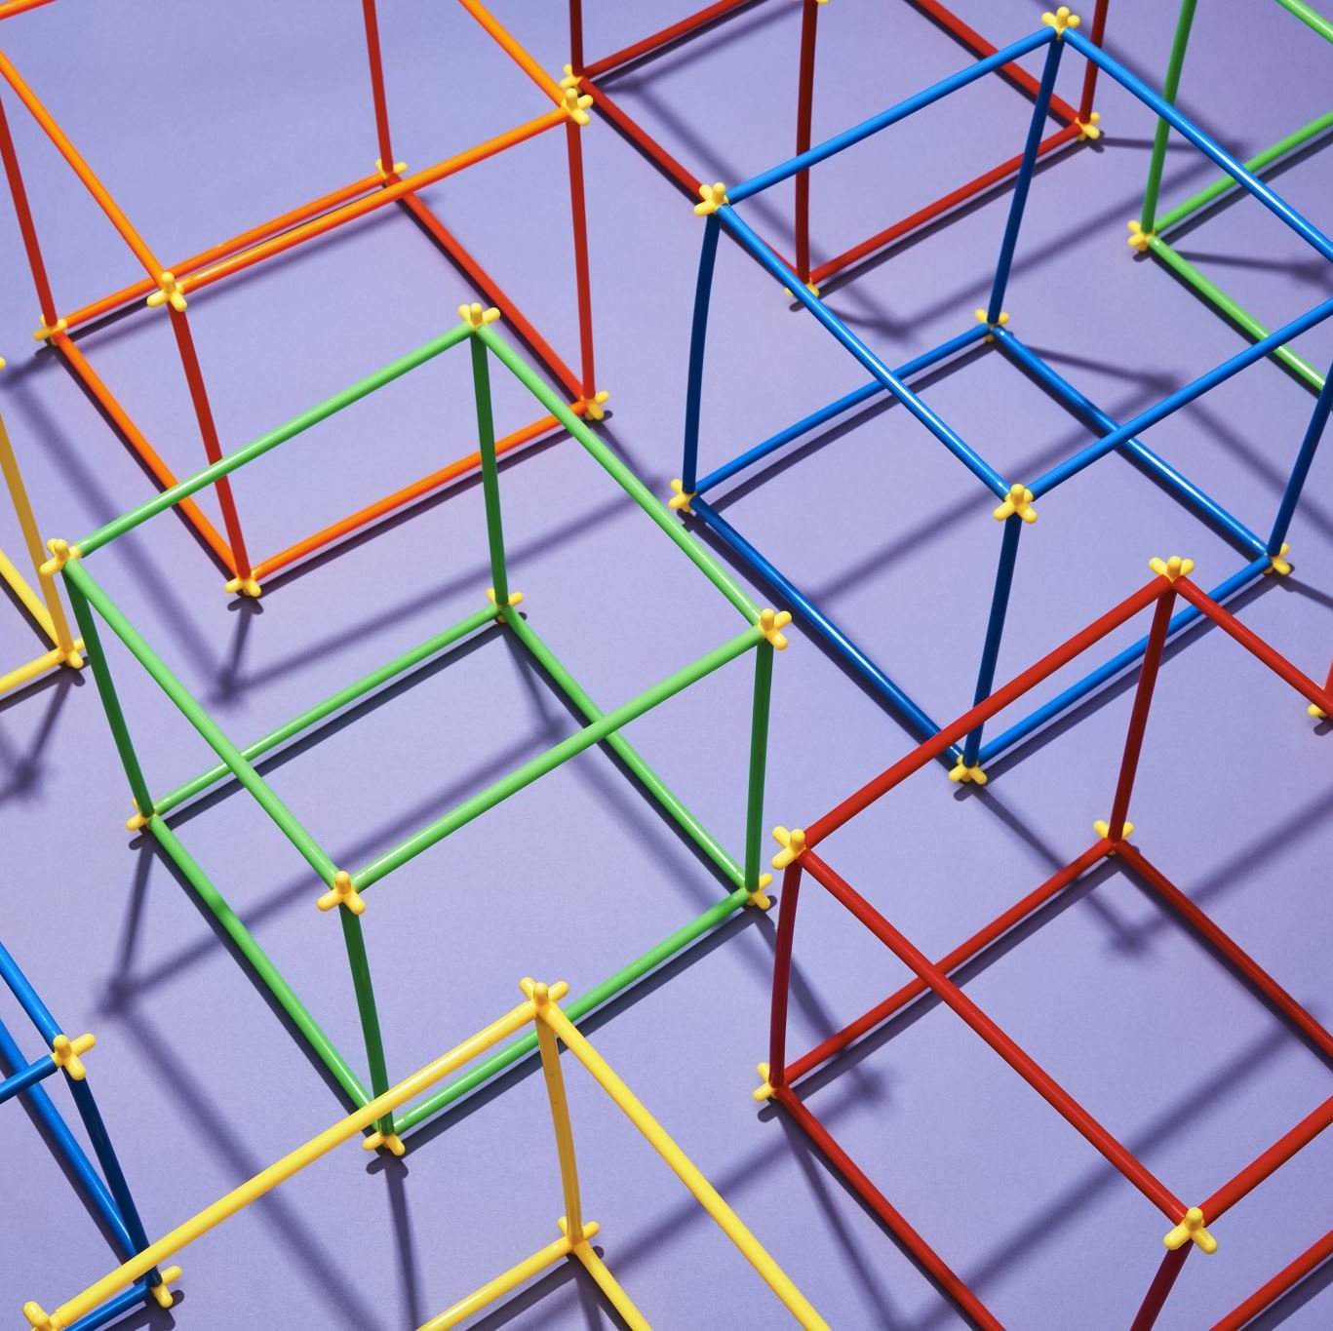
Interfaces between the Layers
The passing of the data and network information down through the layers of the sending device and back up through the layers of the receiving device is made possible
Interface between each pair of adjacent layers.
Defines the information and services a layer must provide for the layer above it.
Well-defined interfaces and layer functions provide modularity to a network.
As long as a layer provides the expected services to the layer above it, the specific implementation of its functions can be modified or replaced without requiring changes to the surrounding layers.

Slide 16
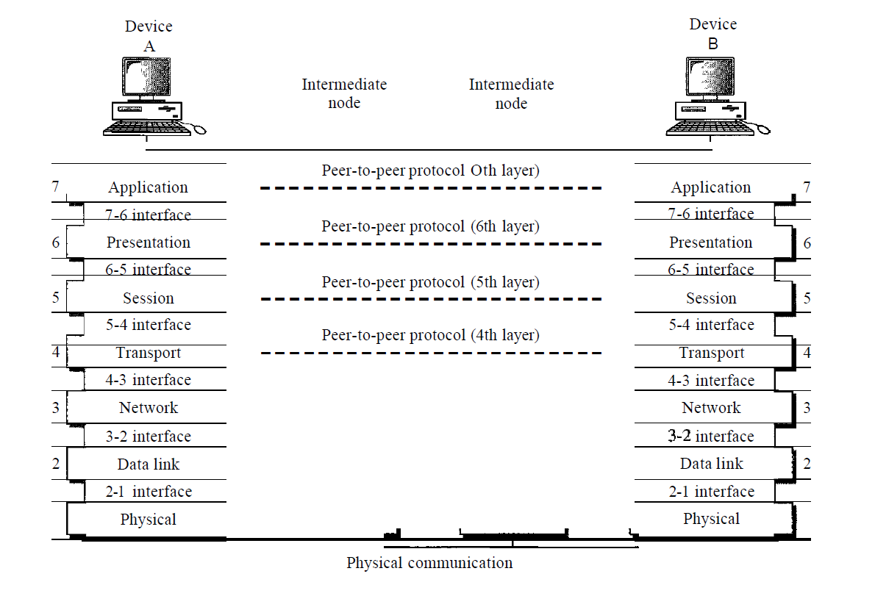

Slide 17
PDU’s And the OSI Model
Layer | PDU Name
7.) Application | Data
6.) Presentation | Data
5.) Session | Data
4.) Transport | Segment
3.) Network | Packet
2.) Data Link | Frame
1.) Physical | Bits
Decapsulation
Encapsulation

